Slide 1
Targeting brachyury in chordoma
Charles Lin
Chordoma Community Conference
MD Anderson Cancer Center
October 28th, 2017

Slide 2
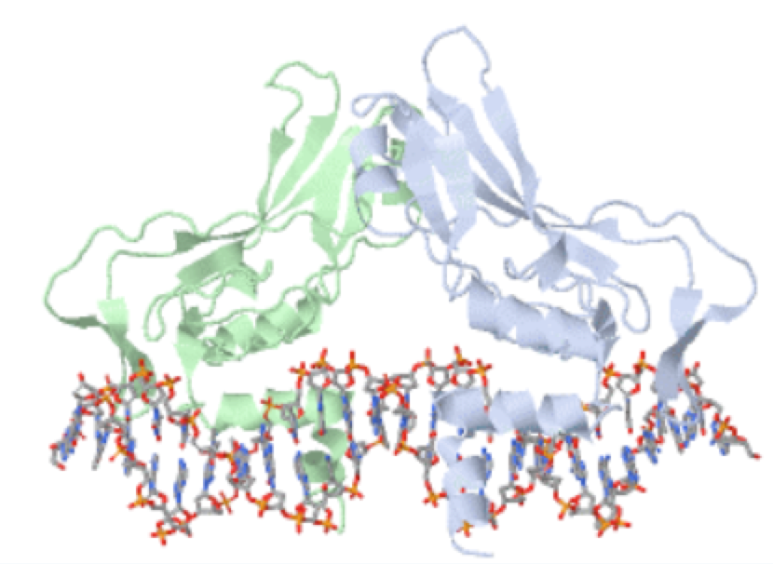
Brachyury is a gene that controls other genes
Brachyury binds to DNA
Brachyury is required in early development
Summary

Slide 3
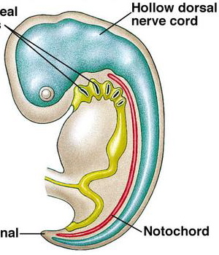
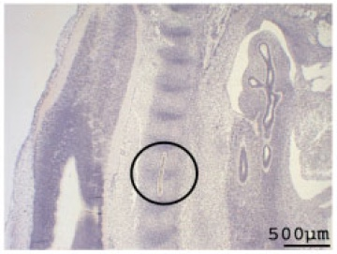
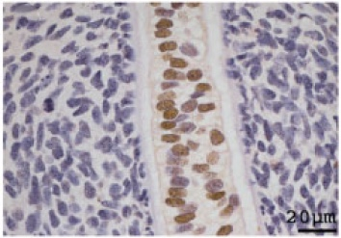
Developing Embryo
Chordoma Tumor Cells
Cells with high brachyury levels
Brachyury in development and chordoma
Vujovic et al., 2006

Slide 4
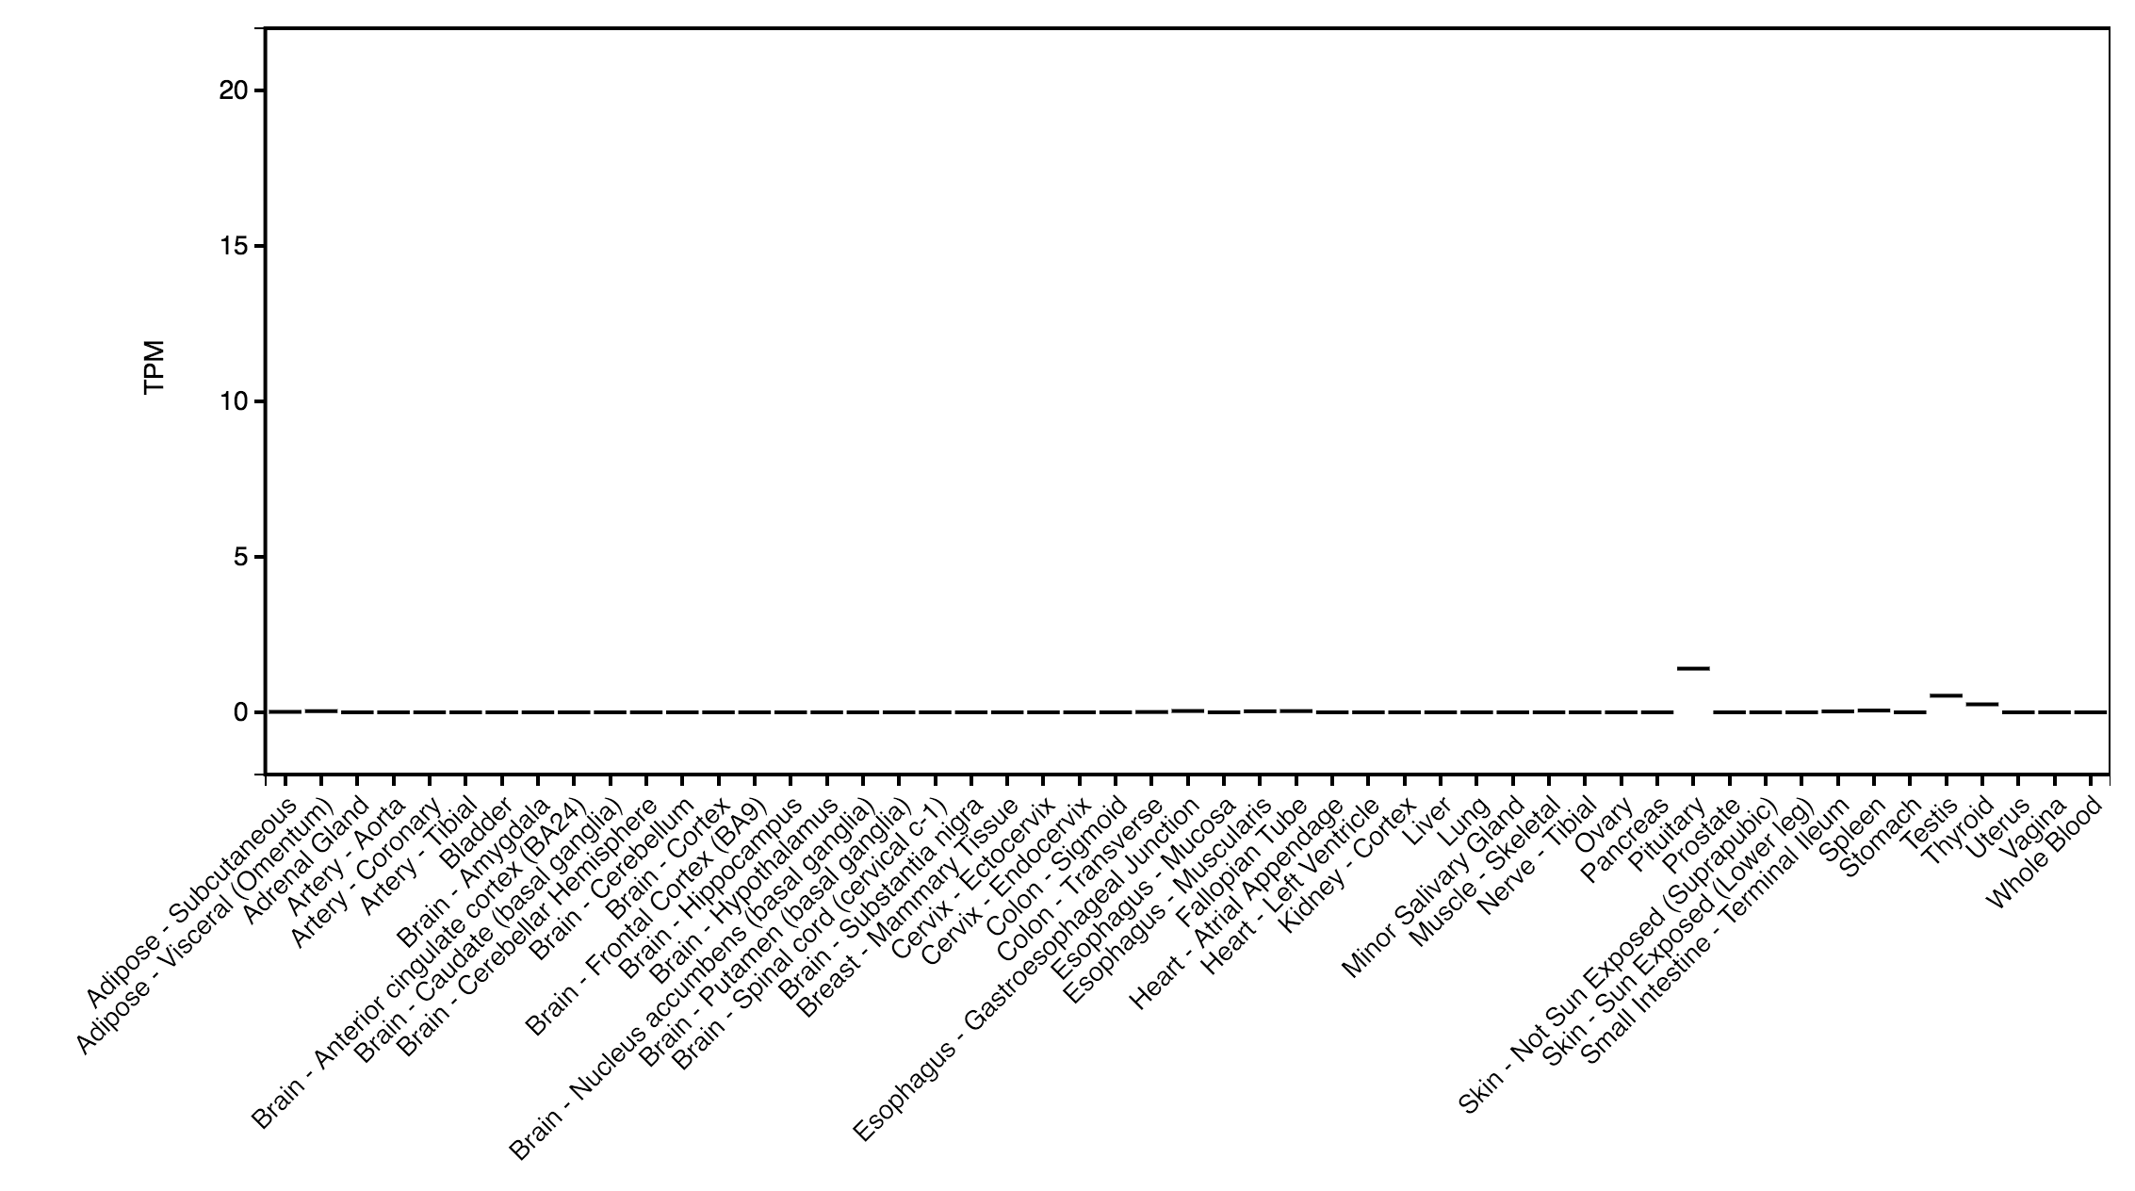
Activity
Tissues in the adult body
Brachyury is not active in most adult tissues
GTEX

Slide 5
Chordoma cells have
failed to turn off brachyury

Slide 6
Senescent cells
Chordoma cells
without brachyury
Chordoma cells with brachyury
Eliminating brachyury halts chordoma growth
Presneau et al., 2011

Slide 7
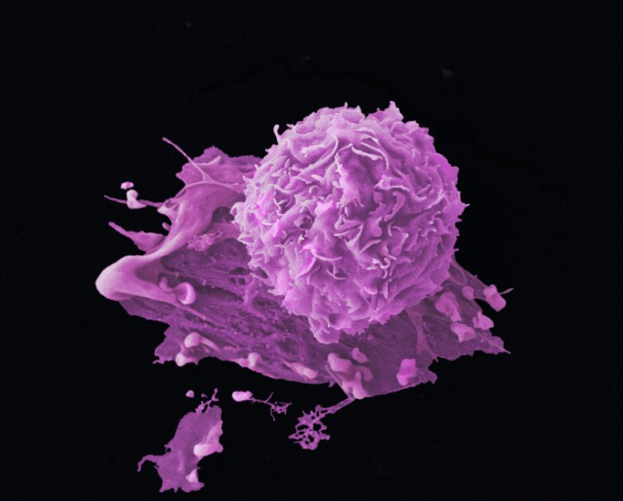
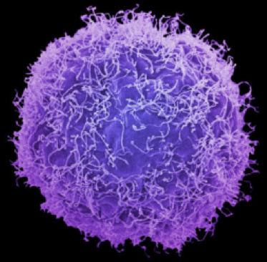
Tumor cells…
forget normal
functions
learn lethal
functions
Brachyury blocks differentiation

Slide 8
We think brachyury is essential in chordoma?
How do we target brachyury?

Slide 9
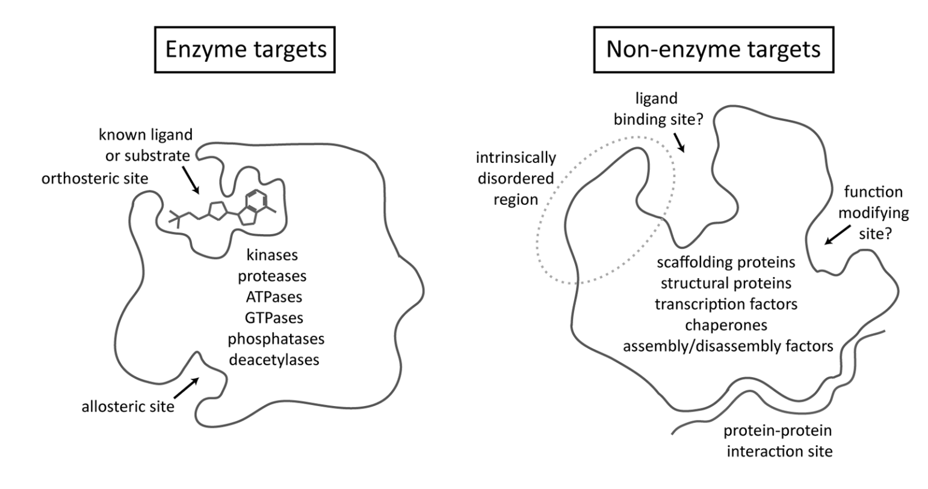
Druggable targets
Undruggable targets
Active site
Bind to inhibit
Brachyury is a classic “undruggable target”
Makley 2013

Slide 10
How do we approach undruggable targets?

Slide 11
Can we turn brachyury off?

Slide 12
Gene turns on
Brachyury is driven by an enhancer

Slide 13
Brachyury is driven by an enhancer
Sharniaf et al.,
Broad Target Chordoma Initiative

Slide 14
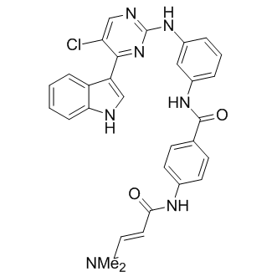
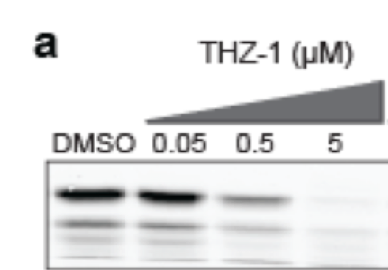
THZ-1
Brachyury levels
We can target enhancers with drugs
Sharniaf et al.,
Broad Target Chordoma Initiative

Slide 15
Targeting brachyury directly
How do we directly target brachyury?
Sharniaf et al.,
Broad Target Chordoma Initiative

Slide 16
Bind to inhibit
Bind only
Undruggable targets have plenty of binding sites
Makley 2013

Slide 17
What happens when you degrade brachyury?

Slide 18
Target protein
DMSO
250
500
degronimid #1
Modeling protein degradation

Slide 19
Brachyury is a gene that controls other genes
Chordoma are addicted to brachyury
We want to drug the proteins that turn brachyury on and develop ways to degrade brachyury
Summary

Slide 20
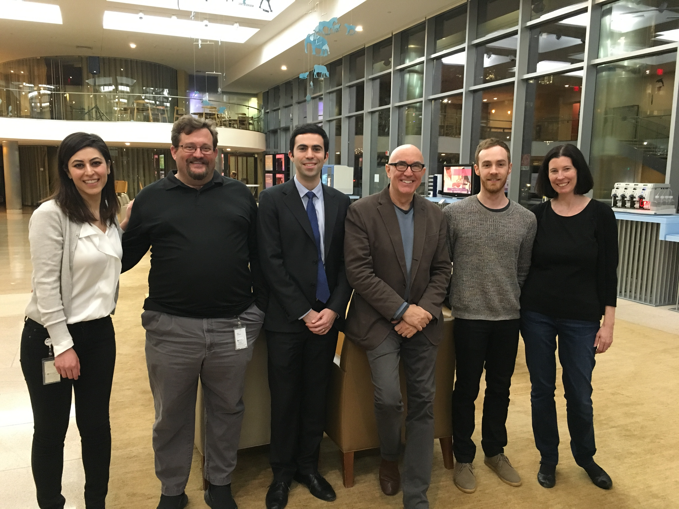
Broad Target Chordoma Initiative
Lin lab
Hadley Sheppard
Rosie Villagomez
Tong Liang
Rohan Bhardwaj
Dana-Farber
James Bradner
Matthew Lawlor
Christopher Ott
Chordoma
Foundation
www.charleslinlab.org
charles.y.lin@bcm.edu
Patty Cogswell
Joan Levy
Acknowledgements

